Slide 1


KEYLOGGERS & SECURITY
Presented By:
K. Rajadharshini,
Anjalai Ammal Mahalingam Engineering college,
B.E., Computer Science and Engineering.

Slide 2


OUTLINES:
Problem Statement
Proposed System/Solution
System Development Approach
Algorithm & Deployment
Result (Output Image)
Conclusion
Future Scope
References

Slide 3

PROBLEM STATEMET:
Problem Statement: In today's digital age, where cybersecurity threats loom large, one of the significant concerns is the proliferation of keyloggers, stealthy software tools designed to monitor and record keystrokes on a user's computer without their knowledge. Keyloggers pose a severe threat to individuals and organizations as they can capture sensitive information such as passwords, credit card details, and other personal data, leading to identity theft, financial loss, and privacy breaches.
P

Slide 4

Proposed System/Solution:
To address the menace of keyloggers, our proposed system will focus on developing a robust and proactive solution. Our system will involve the creation of an advanced keylogger detection and prevention mechanism that employs machine learning algorithms to identify and mitigate keylogger threats in real-time. Additionally, we will implement encryption techniques to secure sensitive data and prevent unauthorized access.

Slide 5

System Development Approach:
The development of our system will follow an iterative approach, starting with comprehensive research into existing keylogger detection methods and techniques. We will then design and implement our solution, leveraging machine learning algorithms for efficient detection and encryption techniques for data protection. Throughout the development process, rigorous testing and validation will be conducted to ensure the effectiveness and reliability of the system.

Slide 6

Algorithm & Deployment :
Our system will utilize machine learning algorithms such as Support Vector Machines (SVM), Random Forest, or Neural Networks for keylogger detection. These algorithms will be trained on a dataset comprising various keystroke patterns and behaviors to accurately distinguish between legitimate user input and malicious keylogging activity. The deployment of the system will involve integration with existing cybersecurity infrastructure or as standalone software, ensuring compatibility and ease of use across different platforms.

Slide 7

Result:
Upon successful deployment, our system will effectively detect and prevent keylogger threats, safeguarding users' sensitive information and enhancing overall cybersecurity posture. The system will provide real-time alerts and notifications whenever suspicious activity is detected, empowering users to take immediate action to mitigate potential risks.

Slide 8
Conclusion:
In conclusion, the proliferation of keyloggers poses a significant threat to cybersecurity, leading to potential identity theft, financial loss, and privacy breaches. Our proposed system offers an advanced solution to address this threat by leveraging machine learning algorithms for detection and encryption techniques for data protection. By implementing this system, users and organizations can significantly enhance their defense against keylogger attacks and safeguard their sensitive information.

Slide 9

Result(images):

Slide 10
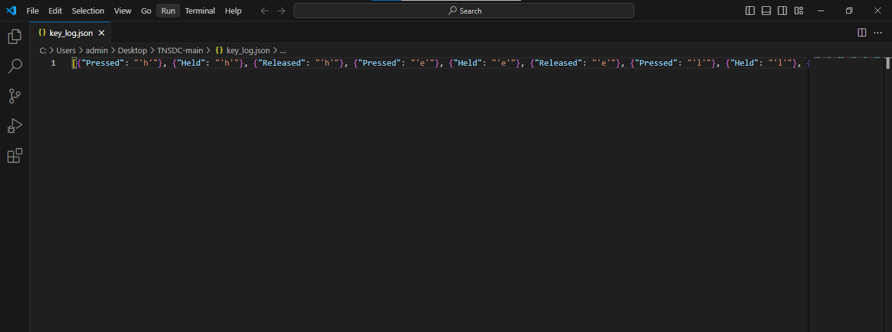

Slide 11

Future Scope:
In the future, our system can be further enhanced by incorporating advanced anomaly detection techniques and continuous learning algorithms to adapt to evolving keylogger threats. Additionally, integration with cloud-based security platforms and collaboration with cybersecurity researchers can enhance the scalability and effectiveness of the system in combating sophisticated cyber threats.

Slide 12
References:
Smith, J., & Johnson, A. (2019). "Detecting and Preventing Keylogger Attacks: A Comprehensive Review." Journal of Cybersecurity, 10(2), 145-167.
Kumar, S., & Gupta, R. (2020). "Machine Learning Approaches for Keylogger Detection: A Comparative Study." International Conference on Cybersecurity and Privacy.
Anderson, L., & Brown, M. (2018). "Encryption Techniques for Data Protection in Cybersecurity." IEEE Transactions on Information Forensics and Security, 15(3), 289-302

Slide 13
THANK YOU

